Slide 1

Frontier AI Risk
Threshold Analyzer
Standardizing risk comparability across AI safety frameworks
PRESENTED BY
Swaleha Parveen, AI Safety Researcher
DATE
March 2026

Slide 2
THE PROBLEM
RESEARCH GAP
Fragmented Safety Frameworks
4+
No common risk language: ASL-3, CCL-2, and CBRN-3 are incomparable across labs and policymakers cannot assess equivalence.
Regulatory ambiguity: EU AI Act mandates action on systemic risk models but labs use different thresholds to define that boundary.
Regulatory arbitrage: Labs can exploit gap between permissive and strict frameworks, choosing whichever minimises obligations.
Research vacuum: No machine-readable database of capability thresholds exists.
Incompatible safety frameworks with no cross-reference standard
AI Safety UAE

Slide 3
SOLUTION
Cross-Framework Risk Analyzer
Three core capabilities enabling global AI safety coordination
AI-Powered Extraction
Structured Database
Compliance Checker
Parses policy documents; normalises threshold definitions across labs automatically
Machine-readable schema mapping risk tiers, capabilities, and eval requirements
Flags regulatory arbitrage gaps and verifies EU AI Act alignment in real-time
AI Safety UAE

Slide 4
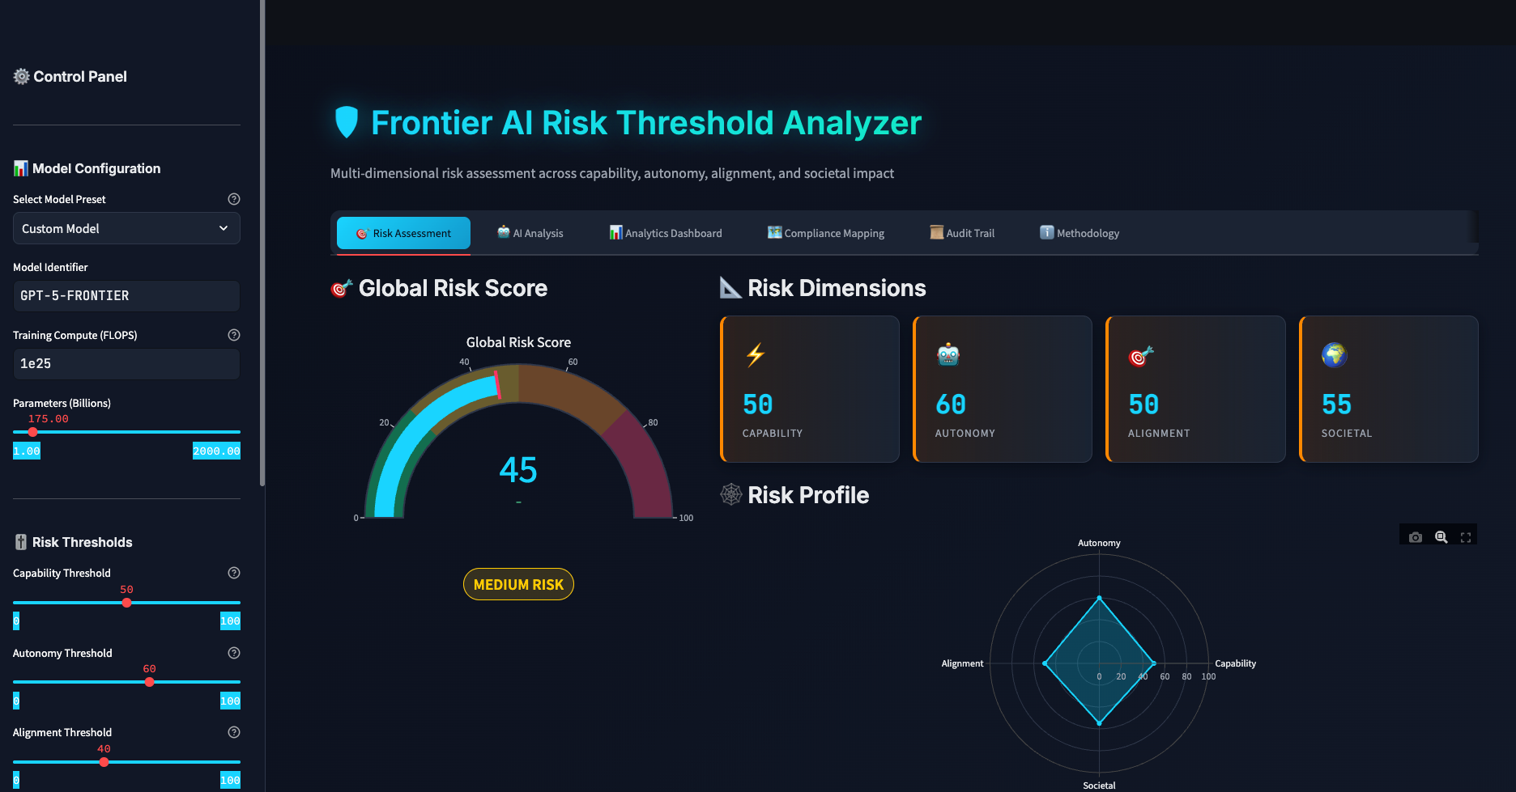
AI Safety UAE

Slide 5

KEY METRICS
What Was Built
47
Risk tiers extracted
156
Capability thresholds mapped
89
Evaluation requirements codified
Database Coverage
Schema spans ASL, CCL, CBRN, and EU AI Act risk tiers. It enables the first objective cross-framework comparison engine for AI safety policy.
AI Safety UAE

Slide 6
ARCHITECTURE
Extraction Pipeline
01
02
03
Ingest
Structure
Assess
Parse frontier lab policy documents using LLM-assisted extraction (PDF and HTML)
Normalise into typed schema: risk tier, threshold type, eval method, capability class
Real-time threshold comparison; flags gaps and regulatory arbitrage mismatches
OpenAI API · custom prompts
Python · JSON schema
Streamlit · open-source
AI Safety UAE

Slide 7
IMPACT
Who Benefits and How
Stakeholders
Outcomes Enabled
AI labs self-assess compliance across multiple jurisdictions
Regulators objectively compare lab commitments and risk levels
Policymakers use structured data as treaty negotiation baseline
Researchers query and extend the open-source threshold dataset
Eliminate framework shopping and regulatory arbitrage
Accelerate EU AI Act systemic risk compliance checks
Provide a foundation for international AI safety treaties
Remove manual overhead from policy threshold analysis
AI Safety UAE

